Slide 1
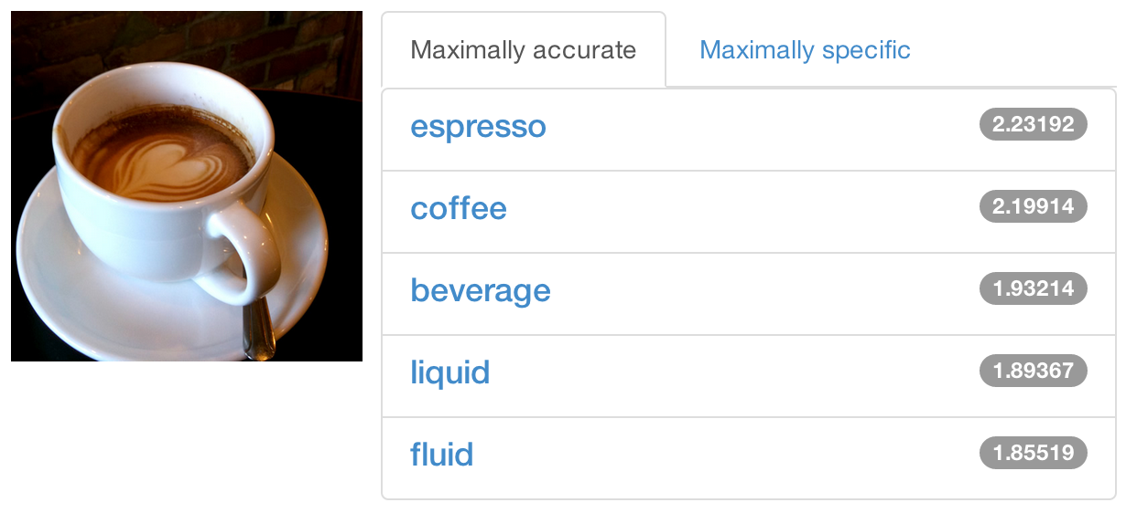
Brewing Deep Networks With Caffe
Caffe Tutorial
Xinlei Chen
Notes:
Yangqing's slides: https://docs.google.com/presentation/d/1AuiPxUy7-Dgb36Q_SN8ToRrq6Nk0X-sOFmr7UnbAAHI/edit#slide=id.p
Caffe DIY tutorial: https://docs.google.com/presentation/d/1UeKXVgRvvxg9OUdh_UiC5G71UMscNPlvArsWER41PsU/edit#slide=id.p

Slide 2
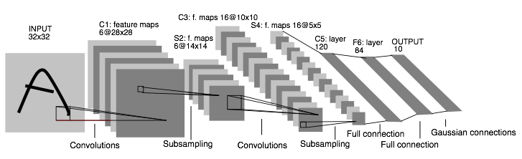
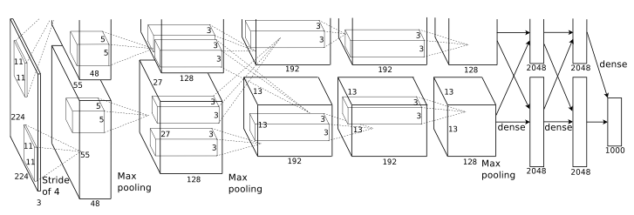
! this->tutorial
What is Deep Learning?
Why Deep Learning?
The Unreasonable Effectiveness of Deep Features
History of Deep Learning.
CNNs 1989
CNNs 2012
LeNet: a layered model composed of convolution and subsampling operations followed by a holistic representation and ultimately a classifier for handwritten digits. [ LeNet ]
AlexNet: a layered model composed of convolution, subsampling, and further operations followed by a holistic representation and all-in-all a landmark classifier on
ILSVRC12. [ AlexNet ]
+ data, + gpu, + non-saturating nonlinearity, + regularization

Slide 3
Frameworks
Torch7
NYU
scientific computing framework in Lua
supported by Facebook
Theano/Pylearn2
U. Montreal
scientific computing framework in Python
symbolic computation and automatic differentiation
Cuda-Convnet2
Alex Krizhevsky
Very fast on state-of-the-art GPUs with Multi-GPU parallelism
C++ / CUDA library
MatConvNet
CXXNet
Mocha

Slide 4
Framework Comparison
More alike than different
All express deep models
All are open-source (contributions differ)
Most include scripting for hacking and prototyping
No strict winners – experiment and choose the framework that best fits your work

Slide 5
Caffe
C++/CUDA deep learning and vision
library of layers
fast, general-purpose for ILSVRC, PASCAL, your data
An active research and development community: public on GitHub
Seamless GPU/CPU switch
Model schemas
Define the model
Configure solver
Finetuning
Wrappers for Python and MATLAB
Virtualbox / EC2 images to be provided soon.
cuda-convnet
C++/CUDA deep learning and vision
library of layers
highly-optimized for given data and GPU
Static codebase, no community contributions: last update Jul 17, 2012
GPU only
Model schemas
Define the model
Write and run solver command
No finetuning
No wrappers: monolithic
*Inflexible*

Slide 6
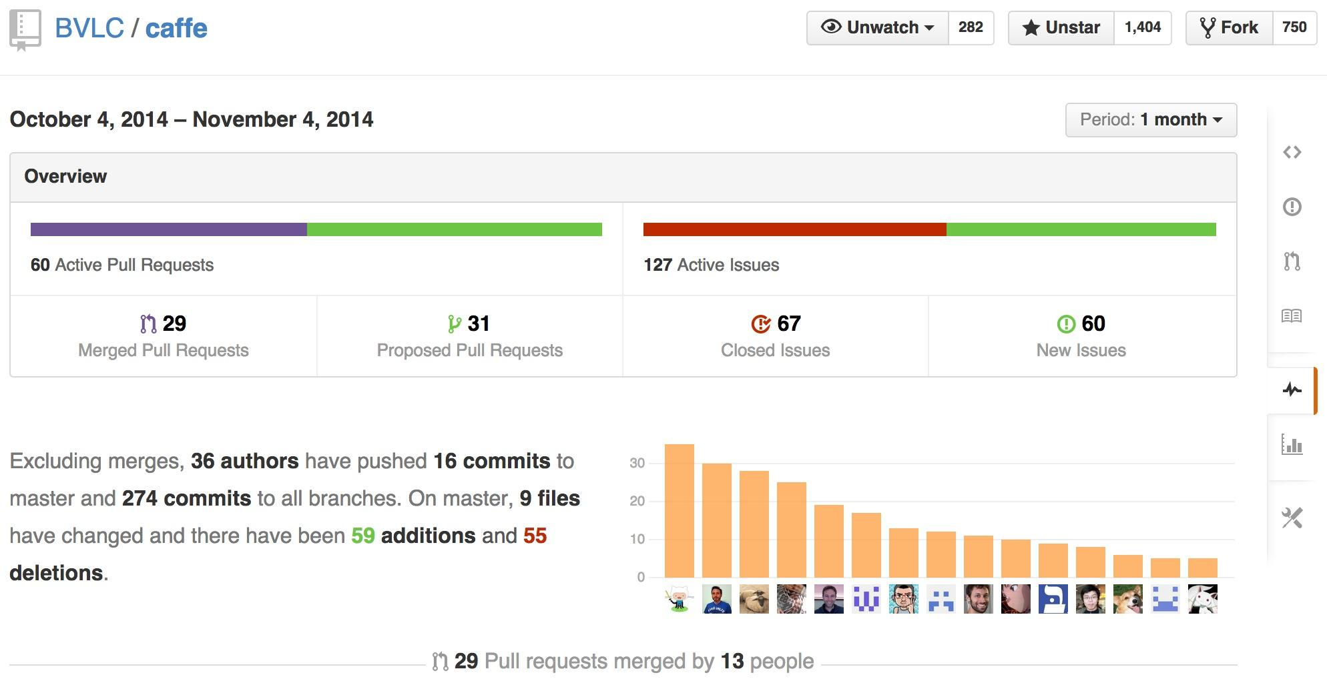
Caffe is a Community project pulse

Slide 7

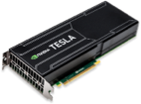
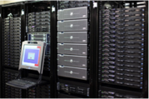
So what is Caffe?
Pure C++ / CUDA architecture for deep learning
command line, Python, MATLAB interfaces
Fast, well-tested code
Tools, reference models, demos, and recipes
Seamless switch between CPU and GPU
Caffe::set_mode(Caffe::GPU);
Prototype
Training
Deployment
All with essentially the same code!

Slide 8
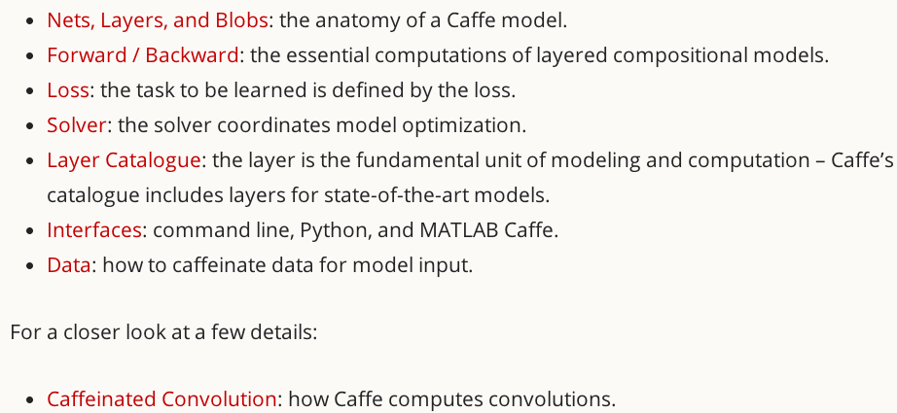
Caffe Tutorial
http:/caffe.berkeleyvision.org//tutorial/

Slide 9
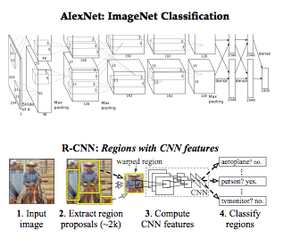
Reference Models
Caffe offers the
model definitions
optimization settings
pre-trained weights
so you can start right away.
The BVLC models are licensed for unrestricted use.

Slide 10
Open Model Collection
The Caffe Model Zoo
- open collection of deep models to share innovation
- VGG ILSVRC14 + Devil models in the zoo
- Network-in-Network / CCCP model in the zoo
- MIT Places scene recognition model in the zoo
- help disseminate and reproduce research
- bundled tools for loading and publishing models
Share Your Models! with your citation + license of course

Slide 11
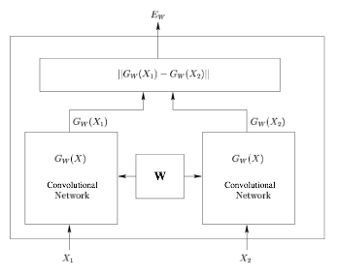
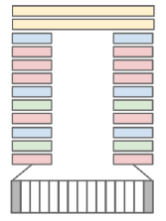
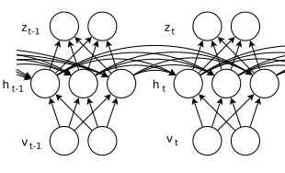
Architectures
DAGs
multi-input
multi-task
Weight Sharing
Recurrent (RNNs)
Sequences
Siamese Nets
Distances
[ Karpathy14 ]
[ Sutskever13 ]
[ Chopra05 ]
Define your own model from our catalogue of layers types and start learning.

Slide 12
Brewing by the Numbers...
Speed with Krizhevsky's 2012 model:
K40 / Titan: 2 ms / image, K20: 2.6ms
Caffe + cuDNN: 1.17ms / image on K40
60 million images / day
8-core CPU: ~20 ms/image
~ 9K lines of C/C++ code
with unit tests ~20k

Slide 13
Why Caffe? In one sip…
Expression: models + optimizations are plaintext schemas, not code.
Speed: for state-of-the-art models and massive data.
Modularity: to extend to new tasks and settings.
Openness: common code and reference models for reproducibility.
Community: joint discussion and development through BSD-2 licensing.

Slide 14
Installation Hints
Always check if a package is already installed
http://ladoga.graphics.cs.cmu.edu/xinleic/NEILWeb/data/install/
Ordering is important
Not working? Check/ask online

Slide 15
Blas
Atlas
MKL
Student license
Not supported by all the architectures
OpenBlas
CuBlas

Slide 16
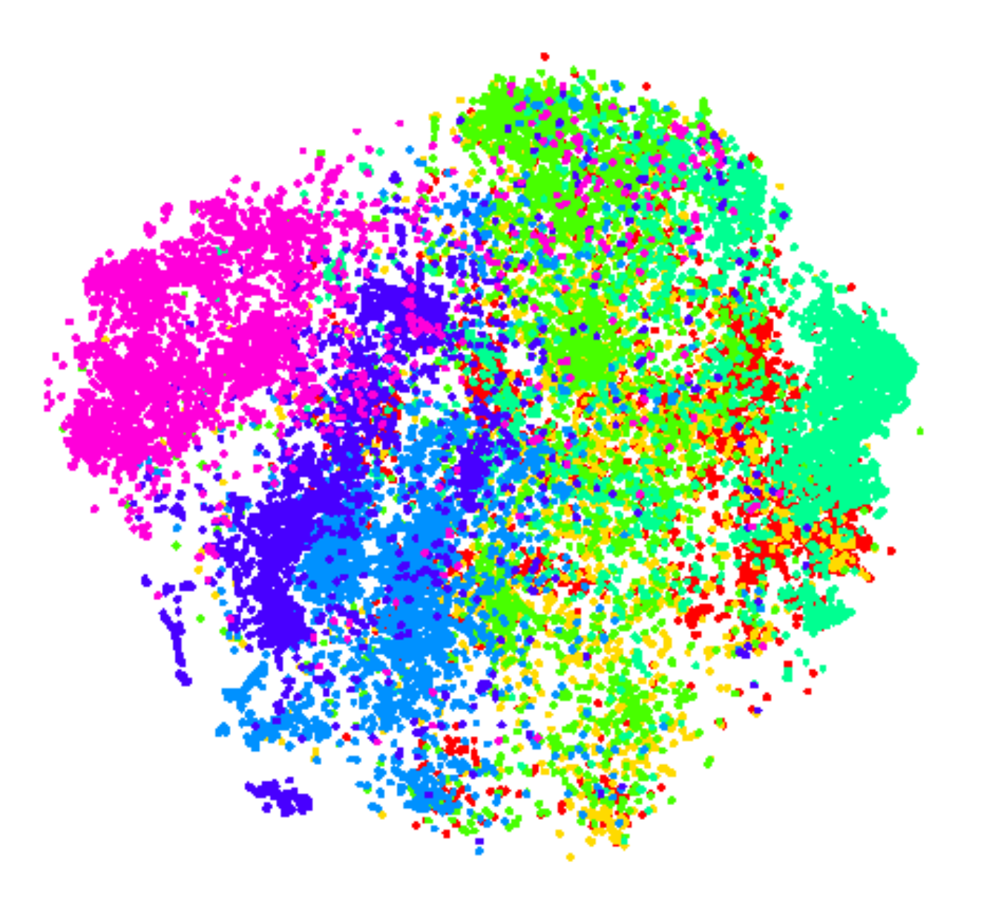
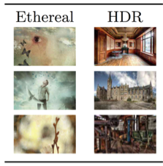
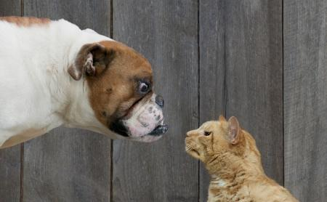
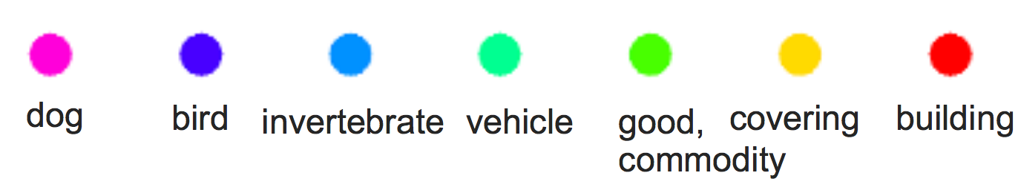
Fine-tuning Transferring learned weights to kick-start models
Take a pre-trained model and fine-tune to new tasks [DeCAF] [Zeiler-Fergus] [OverFeat]
Style
Recognition
Dogs vs.
Cats
top 10 in 10 minutes
Your Task
© kaggle.com

Slide 17
From ImageNet to Style
Simply change a few lines in the layer definition
layers { name: "data" type: DATA
data_param {
source: "ilsvrc12_train_leveldb"
mean_file: "../../data/ilsvrc12"
...
}
...
}
...
layers { name: "fc8" type: INNER_PRODUCT blobs_lr: 1 blobs_lr: 2
weight_decay: 1 weight_decay: 0
inner_product_param {
num_output: 1000
...
}
}
layers { name: "data" type: DATA
data_param {
source: "style_leveldb"
mean_file: "../../data/ilsvrc12"
...
}
...
}
...
layers { name: "fc8-style" type: INNER_PRODUCT blobs_lr: 1 blobs_lr: 2
weight_decay: 1 weight_decay: 0
inner_product_param {
num_output: 20
...
}
}
Input:
A different source
new name = new params
Last Layer:
A different classifier

Slide 18
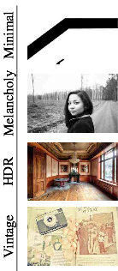
From ImageNet to Style
> caffe train -solver models/finetune_flickr_style/solver.prototxt
-weights bvlc_reference_caffenet.caffemodel
Under the hood (loosely speaking):
net = new Caffe::Net( "style_solver.prototxt");
net.CopyTrainedNetFrom(
pretrained_model);
solver.Solve(net);

Slide 19
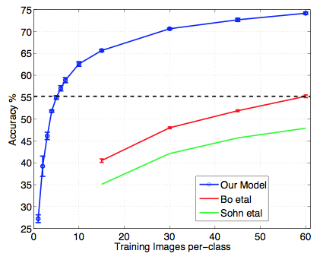
When to Fine-tune?
A good first step!
More robust optimization – good initialization helps
Needs less data
Faster learning
State-of-the-art results in
recognition
detection
segmentation
[Zeiler-Fergus]

Slide 20
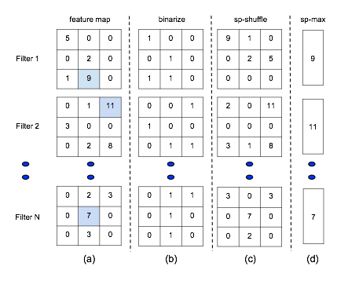
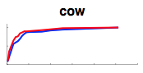
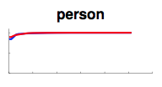
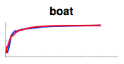
Training & Fine-tuning Analysis
Supervised pre-training does not overfit
Representation is (mostly) distributed
Sparsity comes “for free” in deep representation
P. Agarwal et al. ECCV 14

Slide 21
Fine-tuning Tricks
Learn the last layer first
Caffe layers have local learning rates: blobs_lr
Freeze all but the last layer for fast optimization and avoiding early divergence.
Stop if good enough, or keep fine-tuning
Reduce the learning rate
Drop the solver learning rate by 10x, 100x
Preserve the initialization from pre-training and avoid thrashing

Slide 22
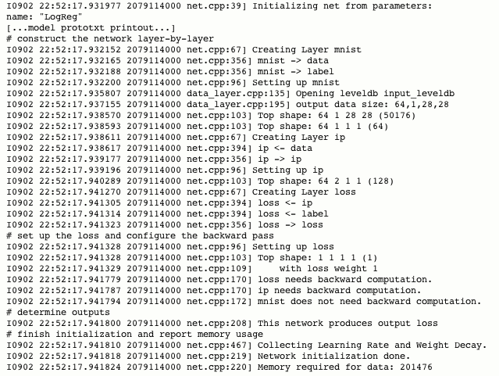

Slide 23
Deeper into caffe

Slide 24
Parameters in Caffe
caffe.proto
Generate classes to pass the parameters
Parameters are listed in order

Slide 25
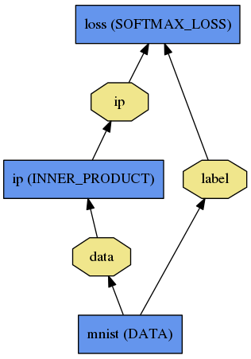
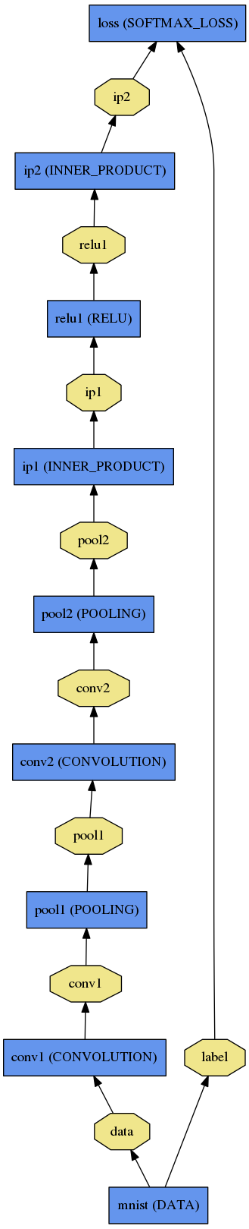
Net
A network is a set of layers connected as a DAG:
name: "dummy-net"
layers { name: "data" …}
layers { name: "conv" …}
layers { name: "pool" …}
… more layers …
layers { name: "loss" …}
LogReg ↑
Caffe creates and checks the net from the definition.
Data and derivatives flow through the net as blobs – a an array interface
LeNet →
ImageNet, Krizhevsky 2012 →

Slide 26
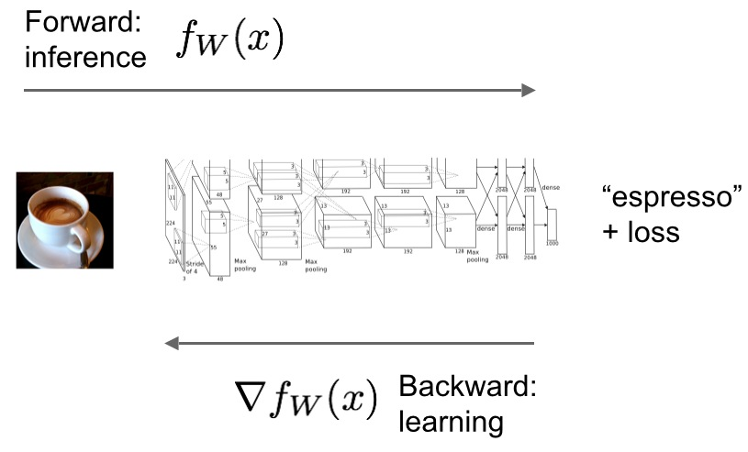
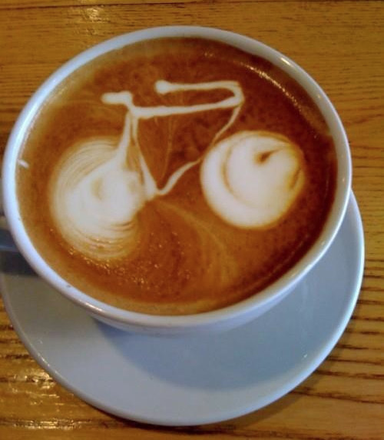
Forward / Backward the essential Net computations
Caffe models are complete machine learning systems for inference and learning.
The computation follows from the model definition. Define the model and run.

Slide 27
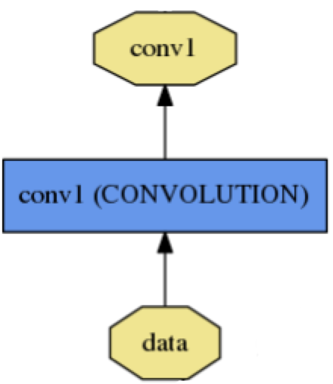
Layer
name: "conv1"
type: CONVOLUTION
bottom: "data"
top: "conv1"
convolution_param {
num_output: 20
kernel_size: 5
stride: 1
weight_filler {
type: "xavier"
}
}
name, type, and the connection structure
(input blobs and output blobs)
layer-specific parameters
- Setup
- Forward
- Backward
Every layer type defines
* Nets + Layers are defined by protobuf schema

Slide 28
Layer Protocol
Setup: run once for initialization.
Forward: make output given input.
Backward: make gradient of output
- w.r.t. bottom
- w.r.t. parameters (if needed)
Model Composition The Net forward and backward passes are the composition the layers’.
Layer Development Checklist

Slide 29
Blob
name: "conv1"
type: CONVOLUTION
bottom: "data"
top: "conv1"
… definition …
Blobs are 4-D arrays for storing and communicating information.
hold data, derivatives, and parameters
lazily allocate memory
shuttle between CPU and GPU
top blob
Data
Number x K Channel x Height x Width
256 x 3 x 227 x 227 for ImageNet train input
Parameter: Convolution Weight
N Output x K Input x Height x Width
96 x 3 x 11 x 11 for CaffeNet conv1
Parameter: Convolution BIas
96 x 1 x 1 x 1 for CaffeNet conv1
bottom blob

Slide 30
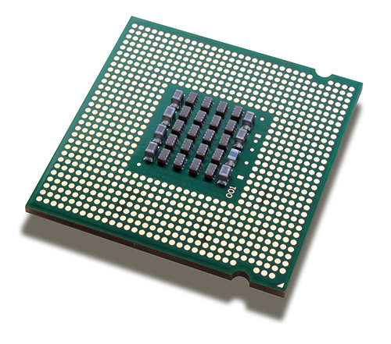
Blob
Blobs provide a unified memory interface.
Reshape(num, channel, height, width)
- declare dimensions
- make SyncedMem -- but only lazily allocate
cpu_data(), mutable_cpu_data()
- host memory for CPU mode
gpu_data(), mutable_gpu_data()
- device memory for GPU mode
SyncedMem
allocation + communication
{cpu,gpu}_diff(), mutable_{cpu,gpu}_diff()
- derivative counterparts to data methods
- easy access to data + diff in forward / backward

Slide 34
GPU/CPU Switch with Blob
Use synchronized memory
Mutable/non-mutable determines whether to copy

Slide 35
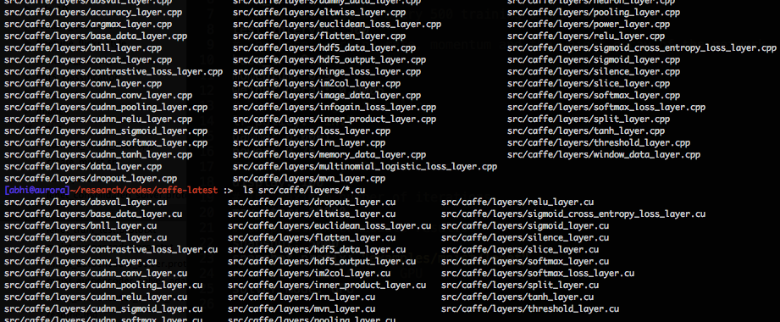
Layers

Slide 36
More about Layers
Data layers
Vision layers
Common layers
Activation/Neuron layers
Loss layers

Slide 37
Data Layers
Data enters through data layers -- they lie at the bottom of nets.
Data can come from efficient databases (LevelDB or LMDB), directly from memory, or, when efficiency is not critical, from files on disk in HDF5/.mat or common image formats.
Common input preprocessing (mean subtraction, scaling, random cropping, and mirroring) is available by specifying TransformationParameters.

Slide 38
Data Layers
DATA
MEMORY_DATA
HDF5_DATA
HDF5_OUTPUT
IMAGE_DATA
WINDOW_DATA
DUMMY_DATA

Slide 39
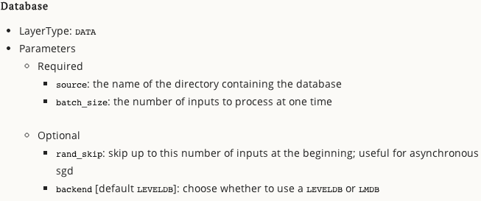
Data Layers

Slide 40
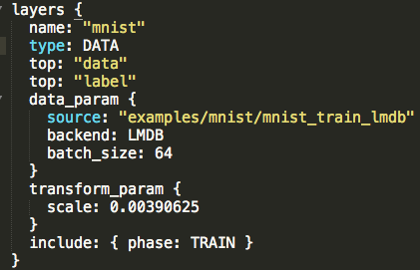
Data Layers

Slide 41
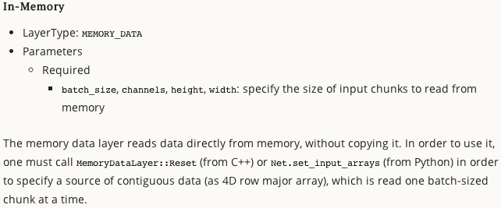
Data Layers

Slide 42
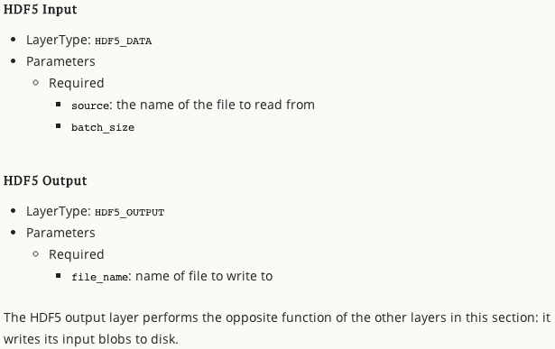

Slide 43
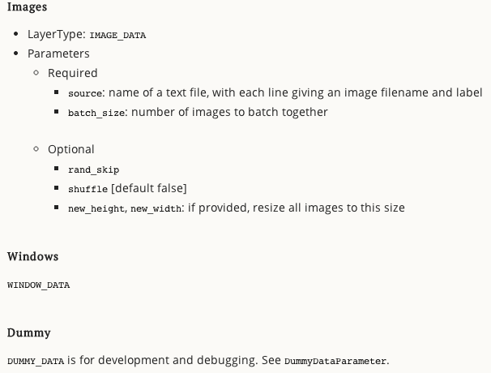

Slide 44
Data Prep
Inputs
Transformations

Slide 45
Inputs
Leveldb/mdb
Raw images
Hdf5/mat files
Images + BB
See examples

Slide 46
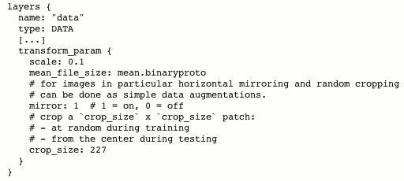
Transformations

Slide 47
More about Layers
Data layers
Vision layers
Common layers
Activation/Neuron layers
Loss layers

Slide 48
Vision Layers
Images as input and produce other images as output.
Non-trivial height h>1 and width w>1.
2D geometry naturally lends itself to certain decisions about how to process the input.
In particular, most of the vision layers work by applying a particular operation to some region of the input to produce a corresponding region of the output.
In contrast, other layers (with few exceptions) ignore the spatial structure of the input, effectively treating it as “one big vector” with dimension “chw”.
Notes:
Layer factory

Slide 49
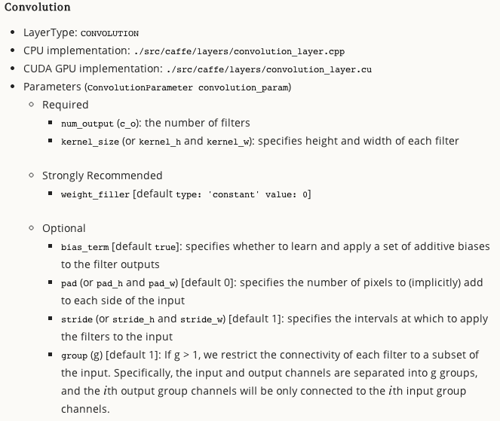
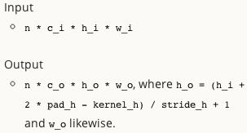
Convolution Layer

Slide 50
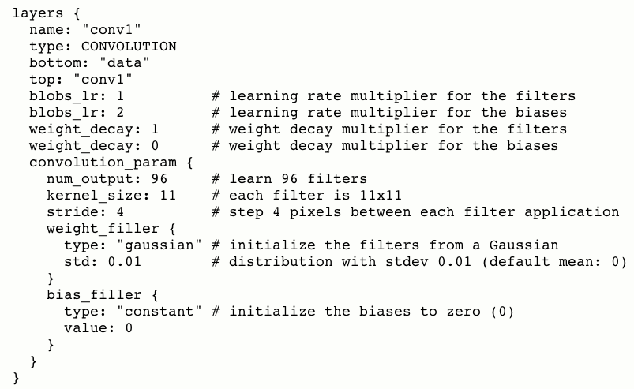

Slide 51
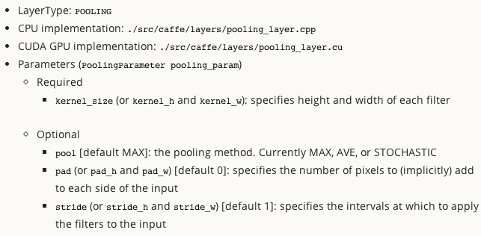
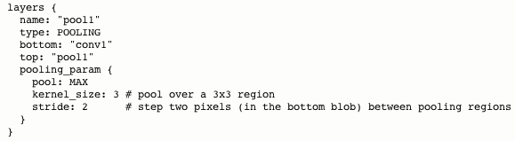
Pooling Layer

Slide 52
Vision Layers
Convolution
Pooling
Local Response Normalization (LRN)
Im2col -- helper

Slide 53
More about Layers
Data layers
Vision layers
Common layers
Activation/Neuron layers
Loss layers

Slide 54
Common Layers
INNER_PRODUCT W^{T}x+b (fully conn)
SPLIT
FLATTEN
CONCAT
SLICE
ELTWISE (element wise operations)
ARGMAX
SOFTMAX
MVN (mean-variance normalization)

Slide 55
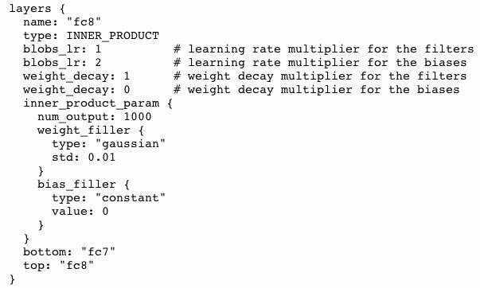

Slide 56
More about Layers
Data layers
Vision layers
Common layers
Activation/Neuron layers
Loss layers

Slide 57
Activation/Neuron layers
One Input Blob
One Output Blob
Both same size

Slide 58
Activation/Neuron layers
RELU
SIGMOID
TANH
ABSVAL
POWER
BNLL (binomial normal log likelihood)

Slide 59
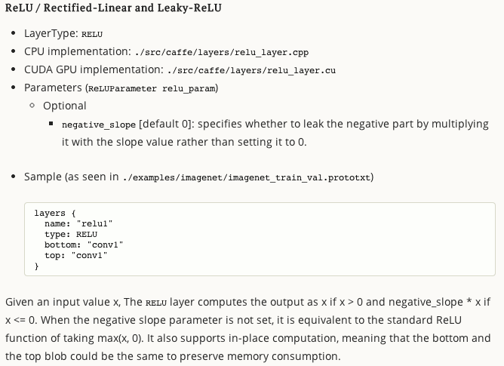
Notes:
Explain what is in-place
Draw on board….

Slide 60
More about Layers
Data layers
Vision layers
Common layers
Activation/Neuron layers
Loss layers

Slide 61
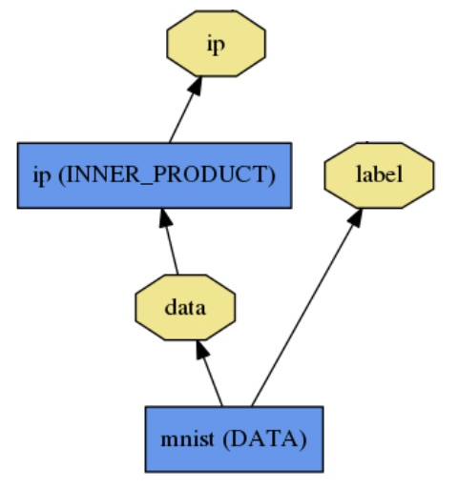
Loss
What kind of model is this?

Slide 62
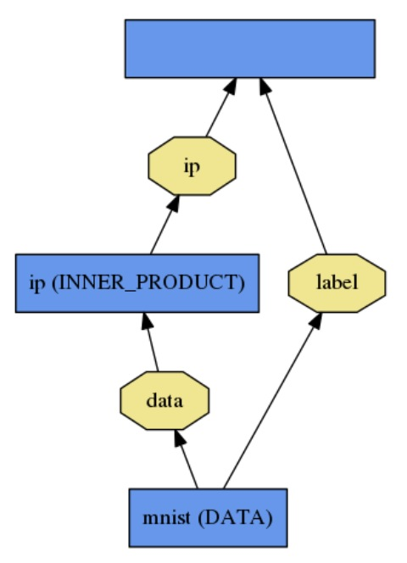
Loss
loss (LOSS_TYPE)
Classification
SOFTMAX_LOSS
HINGE_LOSS
Linear Regression
EUCLIDEAN_LOSS
Attributes / Multiclassification
SIGMOID_CROSS_ENTROPY_LOSS
Others…
New Task
NEW_LOSS
What kind of model is this?
Who knows! Need a loss function.

Slide 63
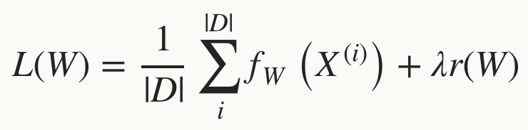
Loss
Loss function determines the learning task.
Given data D, a Net typically minimizes:
Regularization term: penalize large weights to improve generalization
Data term: error averaged over instances

Slide 64
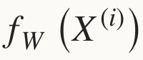
Loss
The data error term is computed by Net::Forward
Loss is computed as the output of Layers
Pick the loss to suit the task – many different losses for different needs

Slide 65
Loss Layers
SOFTMAX_LOSS
HINGE_LOSS
EUCLIDEAN_LOSS
SIGMOID_CROSS_ENTROYPY_LOSS
INFOGAIN_LOSS
ACCURACY
TOPK

Slide 66
Loss Layers
Classification
Linear Regression
Attributes / Multiclassification
Other losses
Not a loss
SOFTMAX_LOSS
HINGE_LOSS
EUCLIDEAN_LOSS
SIGMOID_..._LOSS
INFOGAIN_LOSS
ACCURACY
TOPK
**NEW_LOSS**

Slide 67
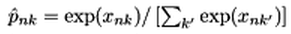
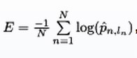
Softmax Loss Layer
Multinomial logistic regression: used for predicting a single class of K mutually exclusive classes
layers { name: "loss" type: SOFTMAX_LOSS bottom: "pred" bottom: "label" top: "loss" }

Slide 68
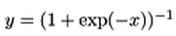
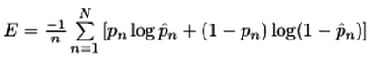
Sigmoid Cross-Entropy Loss
Binary logistic regression: used for predicting K independent probability values in [0, 1]
layers { name: "loss" type: SIGMOID_CROSS_ENTROPY_LOSS bottom: "pred" bottom: "label" top: "loss" }

Slide 69

Euclidean Loss
A loss for regressing to real-valued labels [-inf, inf]
layers { name: "loss" type: EUCLIDEAN_LOSS bottom: "pred" bottom: "label" top: "loss" }

Slide 70

Multiple loss layers
Your network can contain as many loss functions as you want
Reconstruction and Classification:
layers { name: "recon-loss" type: EUCLIDEAN_LOSS bottom: "reconstructions" bottom: "data" top: "recon-loss" }
layers { name: "class-loss" type: SOFTMAX_LOSS bottom: "class-preds" bottom: "class-labels" top: "class-loss" }

Slide 71
Multiple loss layers
“*_LOSS” layers have a default loss weight of 1
layers { name: "loss" type: SOFTMAX_LOSS bottom: "pred" bottom: "label" top: "loss" }
layers { name: "loss" type: SOFTMAX_LOSS bottom: "pred" bottom: "label" top: "loss" loss_weight: 1.0 }
==

Slide 72
Multiple loss layers
Give each loss its own weight
E.g. give higher priority to classification error
layers { name: "recon-loss" type: EUCLIDEAN_LOSS bottom: "reconstructions" bottom: "data" top: "recon-loss" }
layers { name: "class-loss" type: SOFTMAX_LOSS bottom: "class-preds" bottom: "class-labels" top: "class-loss" loss_weight: 100.0 }
100*

Slide 73
Any layer can produce a loss!
Just add loss_weight: 1.0 to have a layer’s output be incorporated into the loss
E = || pred - label ||^2 / (2N)
diff = pred - label
layers { name: "loss" type: POWER bottom: "diff" top: "euclidean_loss"
power_param {
power: 2
}
# = 1/(2N)
loss_weight: 0.0078125 }
E = || diff ||^2 / (2N)
layers { name: "diff" type: ELTWISE bottom: "pred" bottom: "label" top: "diff"
eltwise_param {
op: SUM
coeff: 1
coeff: -1
}
}
layers { name: "loss" type: EUCLIDEAN_LOSS bottom: "pred" bottom: "label" top: "euclidean_loss"
loss_weight: 1.0 }
==
+

Slide 74
Layers
Data layers
Vision layers
Common layers
Activation/Neuron layers
Loss layers
Notes:
Phew..

Slide 75
Layers

Slide 76
Initialization
Gaussian
Xavier
Goal: keep the variance roughly fixed

Slide 77
Solving: Training a Net
Optimization like model definition is configuration.
train_net: "lenet_train.prototxt"
base_lr: 0.01
momentum: 0.9
weight_decay: 0.0005
max_iter: 10000
snapshot_prefix: "lenet_snapshot"
All you need to run things on the GPU.
> caffe train -solver lenet_solver.prototxt -gpu 0
Stochastic Gradient Descent (SGD) + momentum ·
Adaptive Gradient (ADAGRAD) · Nesterov’s Accelerated Gradient (NAG)

Slide 78


Slide 79
Solver
Solver optimizes the network weights W to minimize the loss L(W) over the data D
Coordinates forward / backward, weight updates, and scoring.

Slide 80




Solver
Computes parameter update , formed from
The stochastic error gradient
The regularization gradient
Particulars to each solving method

Slide 81

SGD Solver
Stochastic gradient descent, with momentum
solver_type: SGD

Slide 82
SGD Solver
“AlexNet” [1] training strategy:
Use momentum 0.9
Initialize learning rate at 0.01
Periodically drop learning rate by a factor of 10
Just a few lines of Caffe solver specification:
base_lr: 0.01 lr_policy: "step"
gamma: 0.1 stepsize: 100000 max_iter: 350000
momentum: 0.9

Slide 83


NAG Solver
Nesterov’s accelerated gradient [1]
solver_type: NESTEROV
Proven to have optimal convergence rate for convex problems
[1] Y. Nesterov. A Method of Solving a Convex Programming Problem with Convergence Rate (1/sqrt(k)). Soviet Mathematics Doklady, 1983.

Slide 84

AdaGrad Solver
Adaptive gradient (Duchi et al. [1])
solver_type: ADAGRAD
Attempts to automatically scale gradients based on historical gradients
[1] J. Duchi, E. Hazan, and Y. Singer. Adaptive Subgradient Methods for Online Learning and Stochastic Optimization. The Journal of Machine Learning Research, 2011.

Slide 85
Solver Showdown: MNIST Autoencoder
AdaGrad
SGD
Nesterov
I0901 13:36:30.007884 24952 solver.cpp:232] Iteration 65000, loss = 64.1627 I0901 13:36:30.007922 24952 solver.cpp:251] Iteration 65000, Testing net (#0) # train set I0901 13:36:33.019305 24952 solver.cpp:289] Test loss: 63.217 I0901 13:36:33.019356 24952 solver.cpp:302] Test net output #0: cross_entropy_loss = 63.217 (* 1 = 63.217 loss) I0901 13:36:33.019773 24952 solver.cpp:302] Test net output #1: l2_error = 2.40951
I0901 13:35:20.426187 20072 solver.cpp:232] Iteration 65000, loss = 61.5498 I0901 13:35:20.426218 20072 solver.cpp:251] Iteration 65000, Testing net (#0) # train set I0901 13:35:22.780092 20072 solver.cpp:289] Test loss: 60.8301 I0901 13:35:22.780138 20072 solver.cpp:302] Test net output #0: cross_entropy_loss = 60.8301 (* 1 = 60.8301 loss) I0901 13:35:22.780146 20072 solver.cpp:302] Test net output #1: l2_error = 2.02321
I0901 13:36:52.466069 22488 solver.cpp:232] Iteration 65000, loss = 59.9389 I0901 13:36:52.466099 22488 solver.cpp:251] Iteration 65000, Testing net (#0) # train set I0901 13:36:55.068370 22488 solver.cpp:289] Test loss: 59.3663 I0901 13:36:55.068410 22488 solver.cpp:302] Test net output #0: cross_entropy_loss = 59.3663 (* 1 = 59.3663 loss) I0901 13:36:55.068418 22488 solver.cpp:302] Test net output #1: l2_error = 1.79998

Slide 86



DAG
SDS two-stream net
Many current deep models
have linear structure
GoogLeNet Inception Module
but Caffe nets can have any directed acyclic graph (DAG) structure.
Define bottoms and tops and Caffe will connect the net.
LRCN joint vision-sequence model

Slide 87
Weight sharing
Parameters can be shared and reused across Layers throughout the Net
Applications:
Convolution at multiple scales / pyramids
Recurrent Neural Networks (RNNs)
Siamese nets for distance learning

Slide 88
Weight sharing
Just give the parameter blobs explicit names using the param field
Layers specifying the same param name will share that parameter, accumulating gradients accordingly
layers: {
name: 'innerproduct1'
type: INNER_PRODUCT
inner_product_param {
num_output: 10
bias_term: false
weight_filler {
type: 'gaussian'
std: 10
}
}
param: 'sharedweights'
bottom: 'data'
top: 'innerproduct1'
}
layers: {
name: 'innerproduct2'
type: INNER_PRODUCT
inner_product_param {
num_output: 10
bias_term: false
}
param: 'sharedweights'
bottom: 'data'
top: 'innerproduct2'
}

Slide 89
Interfaces
Command Line
Python
Matlab

Slide 90

CMD
$> Caffe --params

Slide 91


CMD

Slide 92


CMD

Slide 93
Python
$> make pycaffe
python> import caffe
caffe.Net: is the central interface for loading, configuring, and running models.
caffe.Classsifier & caffe.Detector for convenience
caffe.SGDSolver exposes the solving interface.
caffe.io handles I/O with preprocessing and protocol buffers.
caffe.draw visualizes network architectures.
Caffe blobs are exposed as numpy ndarrays for ease-of-use and efficiency**

Slide 94




Python
GOTO: IPython Filter Visualization Notebook

Slide 95

MATLAB

Slide 96
RECENT MODELS
Network-in-Network (NIN)
GoogLeNet
VGG

Slide 97

Network-in-Network
filter with a nonlinear composition instead of a linear filter
1x1 convolution + nonlinearity
reduce dimensionality, deepen the representation
Linear Filter
CONV
NIN / MLP filter
1x1 CONV

Slide 98

GoogLeNet
composition of multi-scale dimension-reduced “Inception” modules
1x1 conv for dimensionality reduction
concatenation across filter scales
multiple losses for training to depth
“Inception” module

Slide 99

VGG
3x3 convolution all the way down...
fine-tuned progression of deeper models
16 and 19 parameter layer variations in the model zoo

Slide 100
Latest Update
Parallelism
Pythonification
Fully Convolutional Networks
Sequences
cuDNN v2
Gradient Accumulation
More
FFT convolution
locally-connected layer
...

Slide 101
Parallelism
Parallel / distributed training across GPUs, CPUs, and cluster nodes
- collaboration with Flickr + open source community
- promoted to official integration branch in PR #1148
- faster learning and scaling to larger data

Slide 102


Fully Convolutional Network: FCN
A framework for spatial prediction by conv. net
applied to semantic segmentation
end-to-end learning
efficiency in inference and learning 175 ms for whole image prediction
multi-modal, multi-task
Further applications
depth estimation
denoising
arXiv

Slide 103

Sequences
Recurrent Net RNN and Long Short Term Memory LSTM are sequential models
video
language
dynamics
learned by back-propagation through time.
LRCN: Long-term Recurrent Convolutional Network
activity recognition
image captioning
video captioning
arXiv

Slide 104


Slide 105
Assignment: New Layer
Write a new Layer
Update caffe.proto
Add in layer list (optionally add new_layer_param)
Add in layer_factory.cpp
Declare in either vision_layers.hpp, data_layers.hpp, common_layers.hpp, neuron_layers.hpp or loss_layers.hpp
Do nearest neighbour copy of existing layer (cpp+cu)
Write SetUp, ForwardPass & BackwardPass (cpp+cu)
Done!!

